Slide 1
Roaming strolling photo booth PHOTO ACTIVATIONS Los Angeles
https://sites.google.com/view/roamingphotoboothrentalat/roaming-digital-photo-booth-beverly-hills
Notes:
https://sites.google.com/view/roamingphotoboothrentalat/roaming-digital-photo-booth-beverly-hills
https://drive.google.com/drive/folders/1Lph-yWlAgUgP_uxC3gBPUaG20KEjlw-Z?usp=sharing
https://news.google.com/rss/search?q=photobooth
https://drive.google.com/drive/folders/1v6RJBPPciyR4CUQ4azRT6bOn5vGySIYG?usp=sharing
https://drive.google.com/drive/folders/1PG6tVu5MA4ciEwEkORX154jPpTveUdrP?usp=sharing
https://drive.google.com/drive/folders/1GWcrAeYz47taJNKdauoVo4KLVnCamDFi?usp=sharing
https://drive.google.com/drive/folders/10DAEZYU1XmG54x6GCK0CF-PKe1fY69QE?usp=sharing
https://drive.google.com/file/d/1kWRAClu3MMOUC0Obv-Z71nDYQTPerzbO/view?usp=sharing
https://drive.google.com/file/d/1DVtCh1W3mkrKOAp7voz2Kjlgboi73WbE/view?usp=sharing
https://drive.google.com/file/d/1MJAeTgbRP-3q0Wo8G0V2nch4Ocw3jfu2/view?usp=sharing
https://drive.google.com/file/d/1mRf9kdwBmfb-_iLDyN4LELpyqCEj0xkQ/view?usp=sharing
https://drive.google.com/file/d/1_MgA1gDAdHq1CruMb6VLaJqigTK8uz4c/view?usp=sharing
https://drive.google.com/file/d/1Qbvzp2GcoSsT1bAp49s_un248g9FO9xx/view?usp=sharing
https://docs.google.com/spreadsheets/d/1TfFhHhmb5N9cwi4HND05SPaGFpwzXJr8P-WM7-pWGvQ/edit?usp=sharing
https://docs.google.com/spreadsheet/pub?key=1TfFhHhmb5N9cwi4HND05SPaGFpwzXJr8P-WM7-pWGvQ
https://docs.google.com/spreadsheets/d/1TfFhHhmb5N9cwi4HND05SPaGFpwzXJr8P-WM7-pWGvQ/pubhtml
https://docs.google.com/spreadsheets/d/1TfFhHhmb5N9cwi4HND05SPaGFpwzXJr8P-WM7-pWGvQ/pub
https://docs.google.com/spreadsheets/d/1TfFhHhmb5N9cwi4HND05SPaGFpwzXJr8P-WM7-pWGvQ/view
https://docs.google.com/forms/d/19VXT1iFgOzaPdsP1hhZp0kyD1tBqK12Sa_rrGjfDbVY/edit?usp=sharing
https://docs.google.com/drawings/d/10d9Y8p5PwFL3I5bboWa3C1y3etVcyw0DO8TVIkKzu9g/edit?usp=sharing
https://drive.google.com/file/d/1Ub_baxN1yIKa7z6PHbWKiQ5Hv3QmkYdb/view?usp=drivesdk
https://sites.google.com/view/culver-city-video-booth-rental/home
https://docs.google.com/document/d/1JyyKAB3ePLjxer3agp3fYSzVFgrdm_0WTnX2yQpemRk/edit?usp=sharing
https://docs.google.com/document/d/1JyyKAB3ePLjxer3agp3fYSzVFgrdm_0WTnX2yQpemRk/pub
https://docs.google.com/document/d/1JyyKAB3ePLjxer3agp3fYSzVFgrdm_0WTnX2yQpemRk/view
https://docs.google.com/presentation/d/1NbWjx6eERiDm9dTkNLy3_q8vb_n9zTVPx8A0KSKFUAU/edit?usp=sharing
https://docs.google.com/presentation/d/1NbWjx6eERiDm9dTkNLy3_q8vb_n9zTVPx8A0KSKFUAU/pub?start=true&loop=true&delayms=3000
https://docs.google.com/presentation/d/1NbWjx6eERiDm9dTkNLy3_q8vb_n9zTVPx8A0KSKFUAU/view
https://docs.google.com/presentation/d/1NbWjx6eERiDm9dTkNLy3_q8vb_n9zTVPx8A0KSKFUAU/htmlpresent

Slide 2
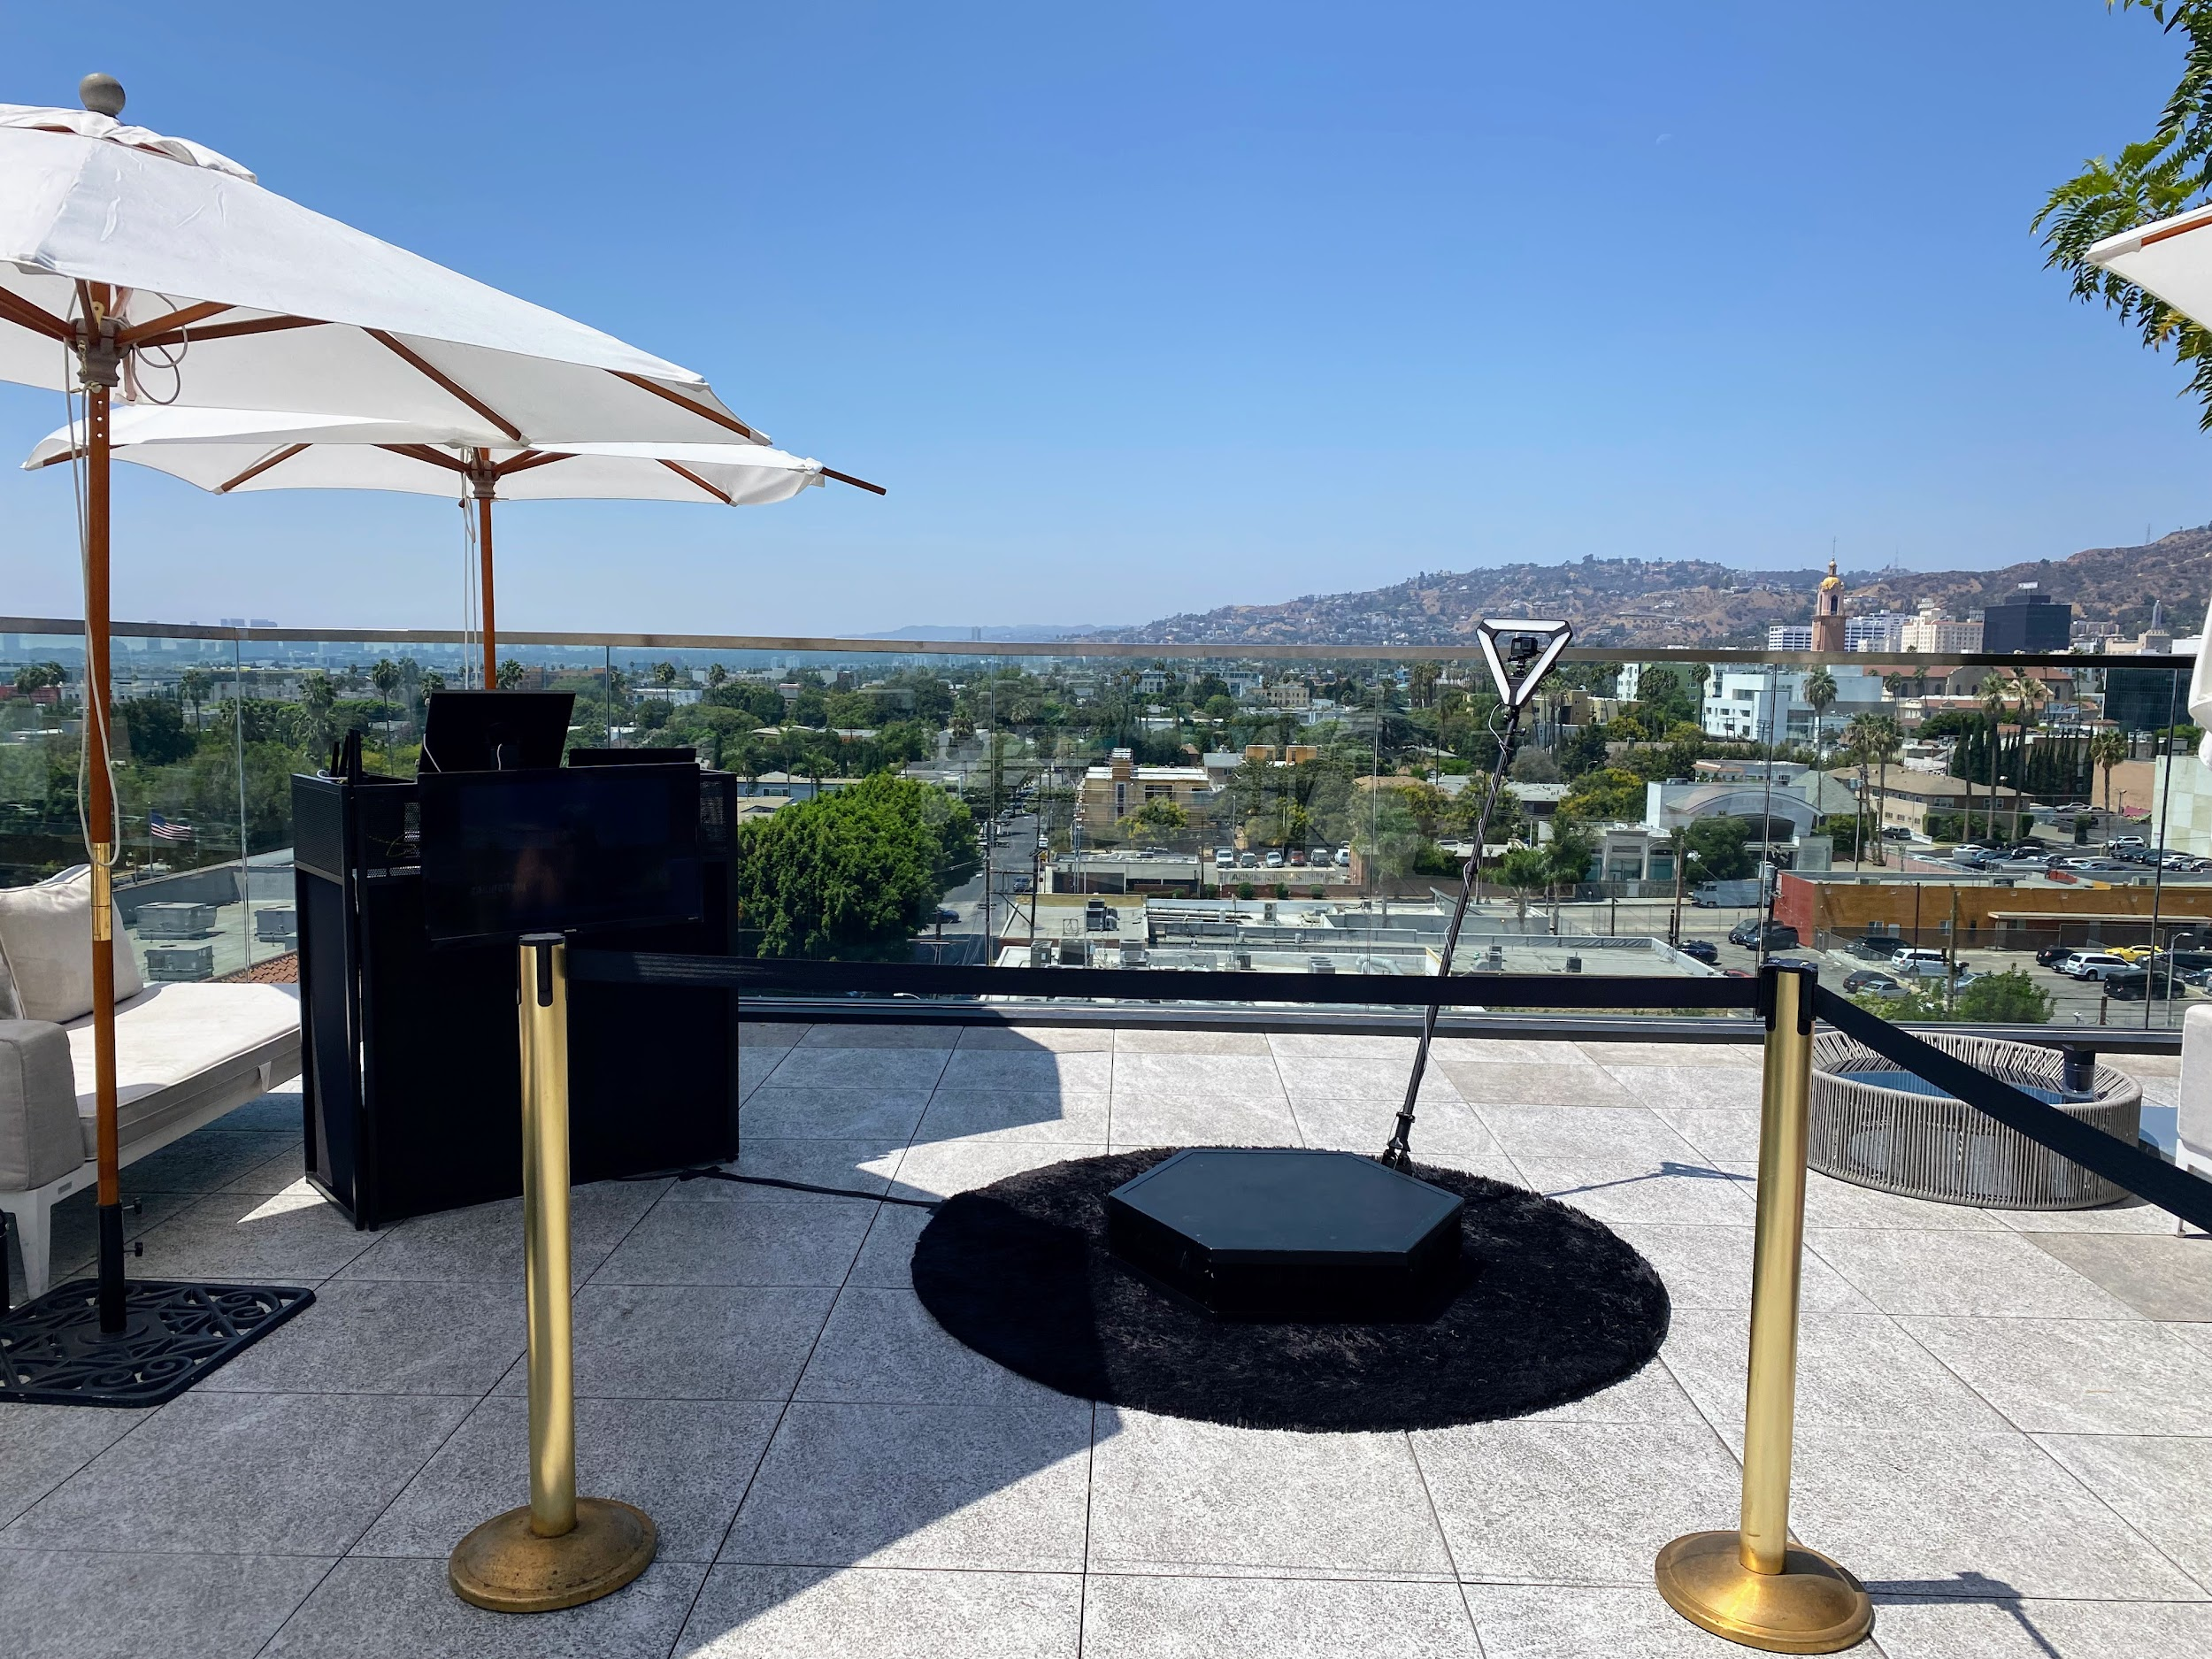

Slide 3
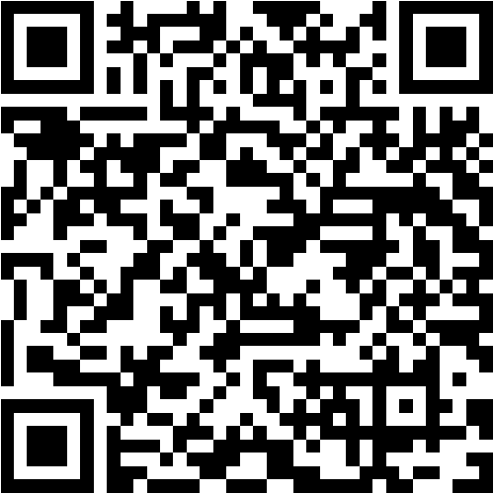

Slide 4
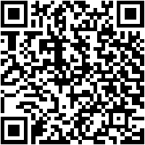
Roaming strolling photo booth PHOTO ACTIVATIONS Los Angeles
Tired of the same old photo booth sitting in the corner? Do you want more interaction with your guests?&nbsp;We literally bring the photo booth to your guests with our Roaming Photo Booth! Our friendly mobile photographers will roam your event, photographing your guests and capture all the action.&nbsp;Guests can continue to select from Photos, Gifs, and Boomerangs, and even make some videos. Our Portable Roamer Photo Booth runs on batteries and can easily move around your event. Our Portable Roamer is great for events indoors and out. The Roamer photo both can send a digital copy to each guest. Because it is extremely portable, we can provide global coverage. Photos and GIFs are customized to match the theme of your event. For an even more enjoyable photo experience, digital photo filters are available.
https://sites.google.com/view/roamingphotoboothrentalat/roaming-digital-photo-booth-beverly-hills
Notes:
Roaming strolling photo booth PHOTO ACTIVATIONS Los Angeles

Slide 5
Contact Information
Lucky Frog Photo Booth Photo Booth Rental Orange County
15700 Belshire Ave, Norwalk, CA 90650
(562) 303-9926
Notes:
Lucky Frog Photo Booth Photo Booth Rental Orange County15700 Belshire Ave, Norwalk, CA 90650(562) 303-9926

Slide 6
More info about us:
Roaming strolling photo booth PHOTO ACTIVATIONS Los Angeles
Notes:
Lucky Frog Photo Booth Photo Booth Rental Orange County15700 Belshire Ave, Norwalk, CA 90650(562) 303-9926

Slide 7


Slide 8
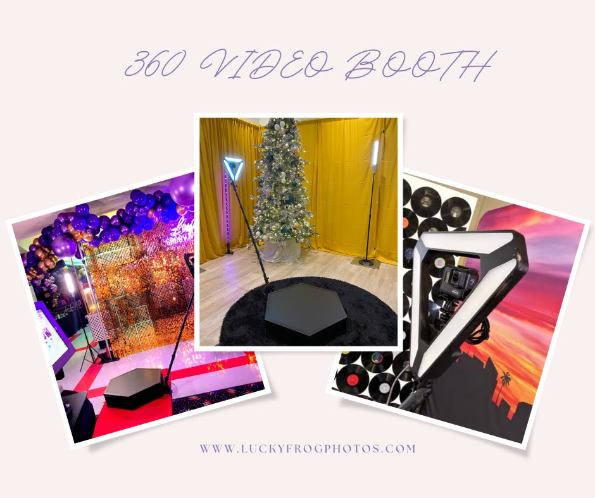

Slide 9


Slide 10
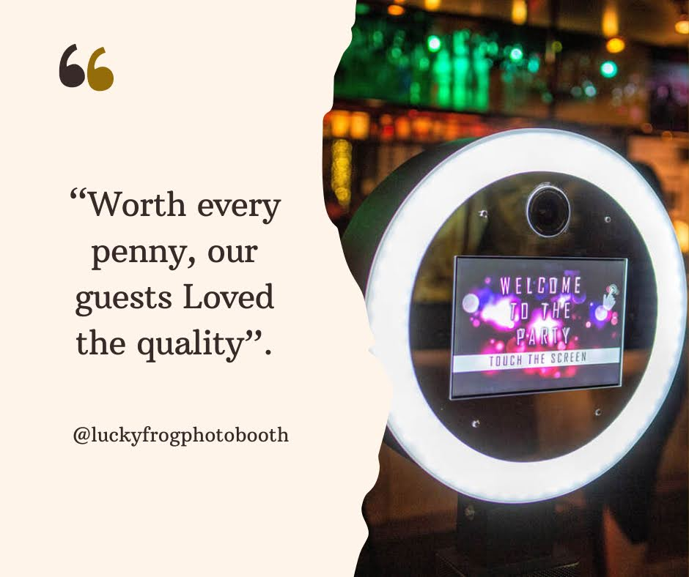

Slide 11
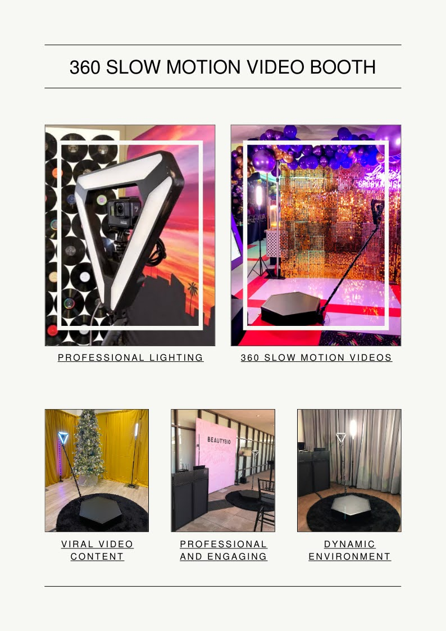

Slide 12
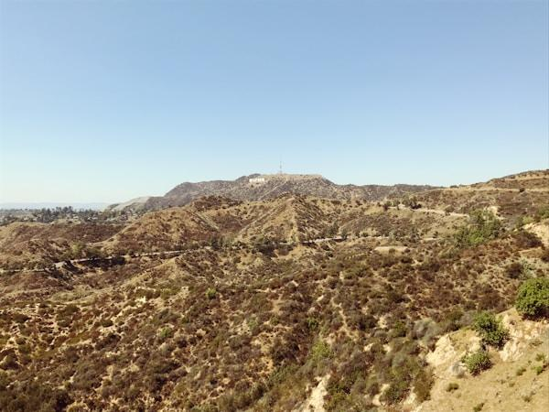

Slide 13
Links
List of recommended resources
Notes:
Roaming strolling photo booth PHOTO ACTIVATIONS Los Angeles

Slide 14
Please visit :
target url
folder top
rss feed
folder articles
folder photos
folder pdfs
folder slides
photo
photo
photo
photo
photo
photo
spreadsheet
spreadsheet key
spreadsheet pubhtml
spreadsheet pub
spreadsheet view
form
drawing
image
image link
document
document pub
document view
presentation
presentation pub
presentation view
presentation html

Slide 15
Videos
YouTube videos we recommend watching!
Notes:
Roaming strolling photo booth PHOTO ACTIVATIONS Los Angeles

Slide 16
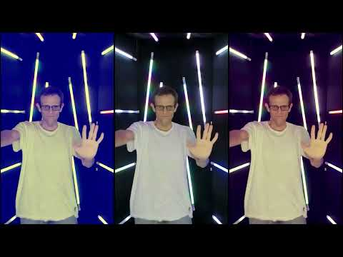
https://sites.google.com/view/roamingphotoboothrentalat/roaming-digital-photo-booth-beverly-hills

Slide 17
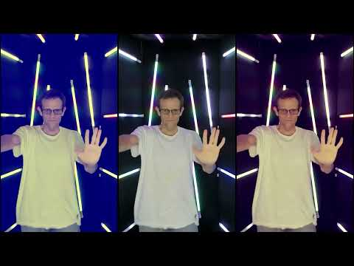
https://sites.google.com/view/roamingphotoboothrentalat/roaming-digital-photo-booth-beverly-hills

Slide 18
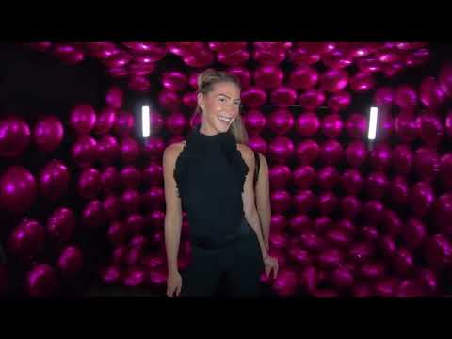
https://sites.google.com/view/roamingphotoboothrentalat/roaming-digital-photo-booth-beverly-hills

Slide 19
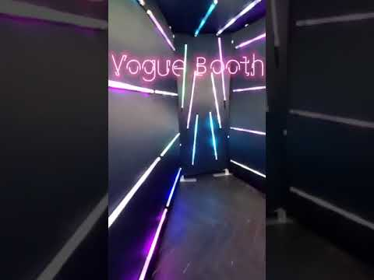
https://sites.google.com/view/roamingphotoboothrentalat/roaming-digital-photo-booth-beverly-hills

Slide 20
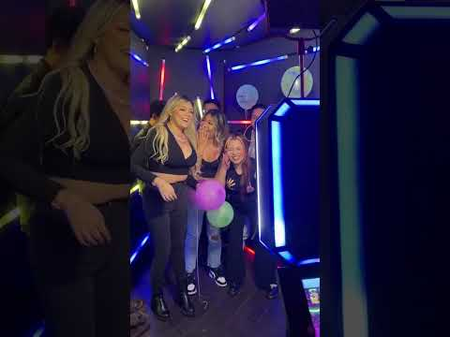
https://sites.google.com/view/roamingphotoboothrentalat/roaming-digital-photo-booth-beverly-hills
Notes:
https://sites.google.com/view/roamingphotoboothrentalat/roaming-digital-photo-booth-beverly-hills
https://drive.google.com/drive/folders/1Lph-yWlAgUgP_uxC3gBPUaG20KEjlw-Z?usp=sharing
https://news.google.com/rss/search?q=photobooth
https://drive.google.com/drive/folders/1v6RJBPPciyR4CUQ4azRT6bOn5vGySIYG?usp=sharing
https://drive.google.com/drive/folders/1PG6tVu5MA4ciEwEkORX154jPpTveUdrP?usp=sharing
https://drive.google.com/drive/folders/1GWcrAeYz47taJNKdauoVo4KLVnCamDFi?usp=sharing
https://drive.google.com/drive/folders/10DAEZYU1XmG54x6GCK0CF-PKe1fY69QE?usp=sharing
https://drive.google.com/file/d/1kWRAClu3MMOUC0Obv-Z71nDYQTPerzbO/view?usp=sharing
https://drive.google.com/file/d/1DVtCh1W3mkrKOAp7voz2Kjlgboi73WbE/view?usp=sharing
https://drive.google.com/file/d/1MJAeTgbRP-3q0Wo8G0V2nch4Ocw3jfu2/view?usp=sharing
https://drive.google.com/file/d/1mRf9kdwBmfb-_iLDyN4LELpyqCEj0xkQ/view?usp=sharing
https://drive.google.com/file/d/1_MgA1gDAdHq1CruMb6VLaJqigTK8uz4c/view?usp=sharing
https://drive.google.com/file/d/1Qbvzp2GcoSsT1bAp49s_un248g9FO9xx/view?usp=sharing
https://docs.google.com/spreadsheets/d/1TfFhHhmb5N9cwi4HND05SPaGFpwzXJr8P-WM7-pWGvQ/edit?usp=sharing
https://docs.google.com/spreadsheet/pub?key=1TfFhHhmb5N9cwi4HND05SPaGFpwzXJr8P-WM7-pWGvQ
https://docs.google.com/spreadsheets/d/1TfFhHhmb5N9cwi4HND05SPaGFpwzXJr8P-WM7-pWGvQ/pubhtml
https://docs.google.com/spreadsheets/d/1TfFhHhmb5N9cwi4HND05SPaGFpwzXJr8P-WM7-pWGvQ/pub
https://docs.google.com/spreadsheets/d/1TfFhHhmb5N9cwi4HND05SPaGFpwzXJr8P-WM7-pWGvQ/view
https://docs.google.com/forms/d/19VXT1iFgOzaPdsP1hhZp0kyD1tBqK12Sa_rrGjfDbVY/edit?usp=sharing
https://docs.google.com/drawings/d/10d9Y8p5PwFL3I5bboWa3C1y3etVcyw0DO8TVIkKzu9g/edit?usp=sharing
https://drive.google.com/file/d/1Ub_baxN1yIKa7z6PHbWKiQ5Hv3QmkYdb/view?usp=drivesdk
https://sites.google.com/view/culver-city-video-booth-rental/home
https://docs.google.com/document/d/1JyyKAB3ePLjxer3agp3fYSzVFgrdm_0WTnX2yQpemRk/edit?usp=sharing
https://docs.google.com/document/d/1JyyKAB3ePLjxer3agp3fYSzVFgrdm_0WTnX2yQpemRk/pub
https://docs.google.com/document/d/1JyyKAB3ePLjxer3agp3fYSzVFgrdm_0WTnX2yQpemRk/view
https://docs.google.com/presentation/d/1NbWjx6eERiDm9dTkNLy3_q8vb_n9zTVPx8A0KSKFUAU/edit?usp=sharing
https://docs.google.com/presentation/d/1NbWjx6eERiDm9dTkNLy3_q8vb_n9zTVPx8A0KSKFUAU/pub?start=true&loop=true&delayms=3000
https://docs.google.com/presentation/d/1NbWjx6eERiDm9dTkNLy3_q8vb_n9zTVPx8A0KSKFUAU/view
https://docs.google.com/presentation/d/1NbWjx6eERiDm9dTkNLy3_q8vb_n9zTVPx8A0KSKFUAU/htmlpresent

Slide 21
Roaming strolling photo booth PHOTO ACTIVATIONS Los Angeles
https://sites.google.com/view/roamingphotoboothrentalat/roaming-digital-photo-booth-beverly-hills
Notes:
Roaming strolling photo booth PHOTO ACTIVATIONS Los Angeles

